Slide 1
Android App For Covid_19 detection using Transfer Learning
By :
Vibhav Joshi (Research internship in bioinformatics and medical imaging)
Pratik Patil

Slide 2
Content
Abstract
Goals & Objectives
Proposed System
Model trained
CNN Algorithm
Future Scope and Research
Use-cases of App
System Architecture

Slide 3
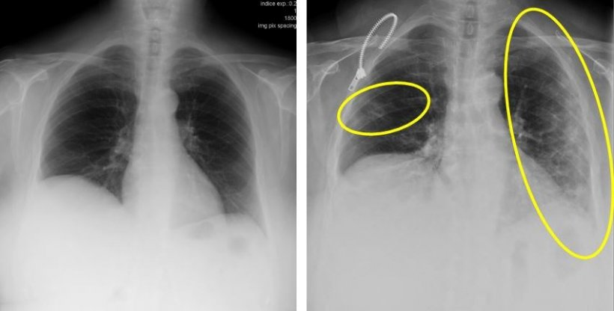
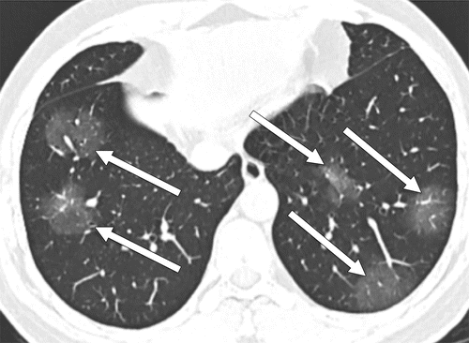
Abstract
How radiology help us detecting Covid_19 from Xrays?
Radiology is fundamental in this process. The radiologist's main contribution is to facilitate and expedite as much as possible the exploration, help design specific circuits and provide a fast and accurate report of the radiological findings that should indicate whether or not these are consistent with the COVID-19 coronavirus infection
Notes:
First, What is Parkinson Disease? PD is a motor system disorder resulting from the loss of the brain cells producing dopamine. It is a neurodegenerative disease.
On the right, the usual symptoms experienced by a PD person: The picture chooses a old man, because men over 60 are the most common person affected by the disease.

Slide 4
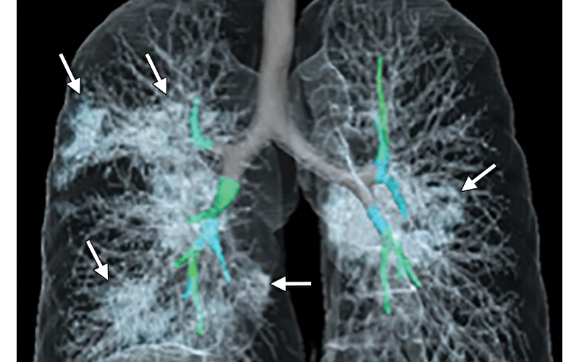
What are the typical radiological findings?
The findings that make us strongly suspect that we are dealing with a COVID-19 infection are the ground glass patterned areas, which, even in the initial stages, affect both lungs, in particular the lower lobes, and especially the posterior segments, with a fundamentally peripheral and subpleural distribution. These findings are present on chest CT in practically 50% of patients in the first two days; For this, in China, CT is being used as a screening or diagnostic method
Changes over time
Advanced-phase disease is associated with a significantly increased frequency of:
GGO plus a reticular pattern (crazy pavin)
Vacuolar sign
Fibrotic streaks
Air bronchogram
Bronchus distortion
Subpleural line or a subpleural transparent line
Pleural effusion

Slide 5
Goals & Objectives
Detection of Covid-19 Disease using proper Biomarkers
Making a model with trained data to classify the the person if he is suffering from Covid-19 or not?(Medical imaging and bioinformatics)
Make use of dataset that consist covid_19 Xray of Lungs and build a classification model that can be used in Android App

Slide 6
Proposed system
First we collect all the Data and then build a Model using deep learning(Transfer Learning) and build a classification model for Covid-19 detection
The we use the tensorflow.lite model and use it Android Phone and make a application
The application will take image of Xray and tell us if it is Covid_19 or not

Slide 7
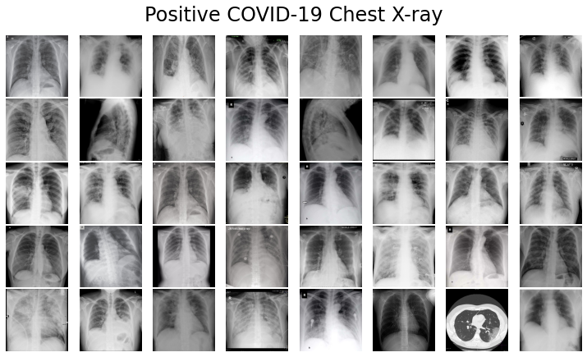

Slide 8
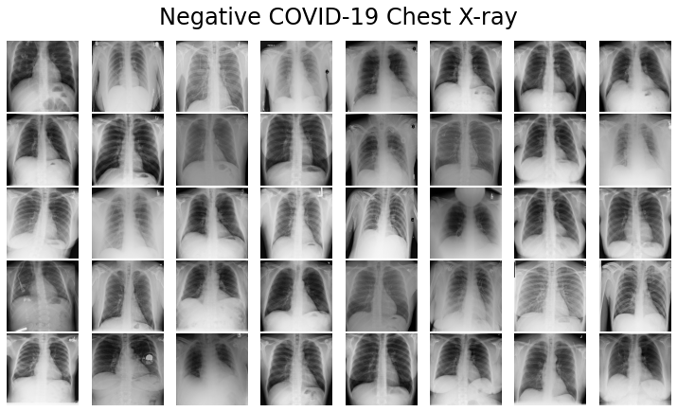

Slide 9

Use Of Azure Sql Database
We have used Azure Sql database to store patient Information like Name,Age,Gender,Medical condition like heart disease and Diabetes
This Will Help us in Analysis and alert the patient if he has Covid and has any medical condition that can be fatal
Azure Sql is easy to integrate in Application using different connection strings,We have used JDBC

Slide 10
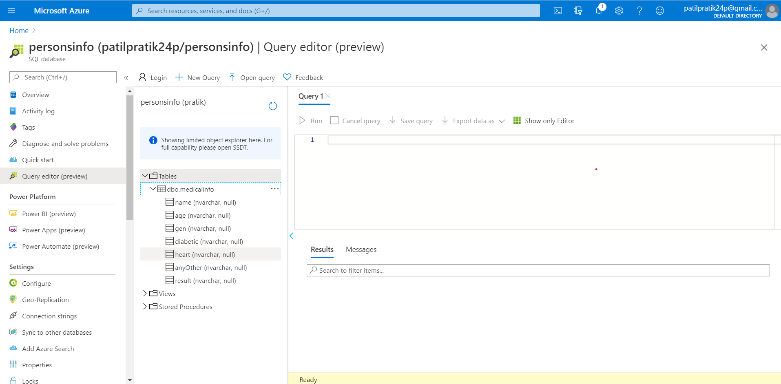
Azure SQL Database

Slide 11
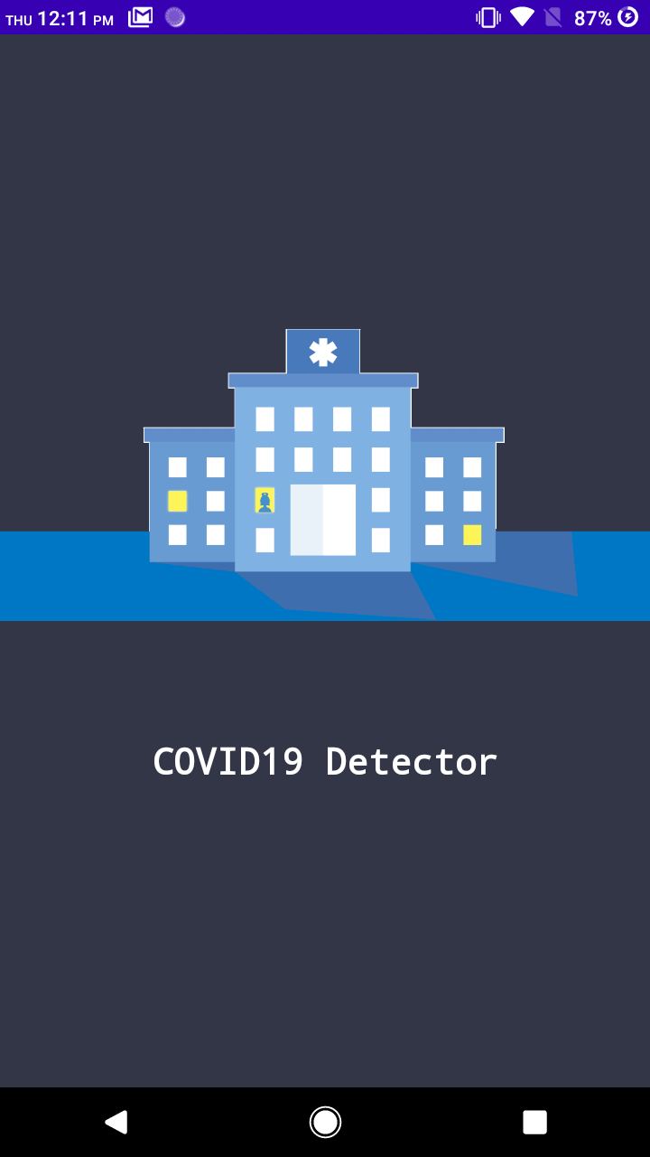
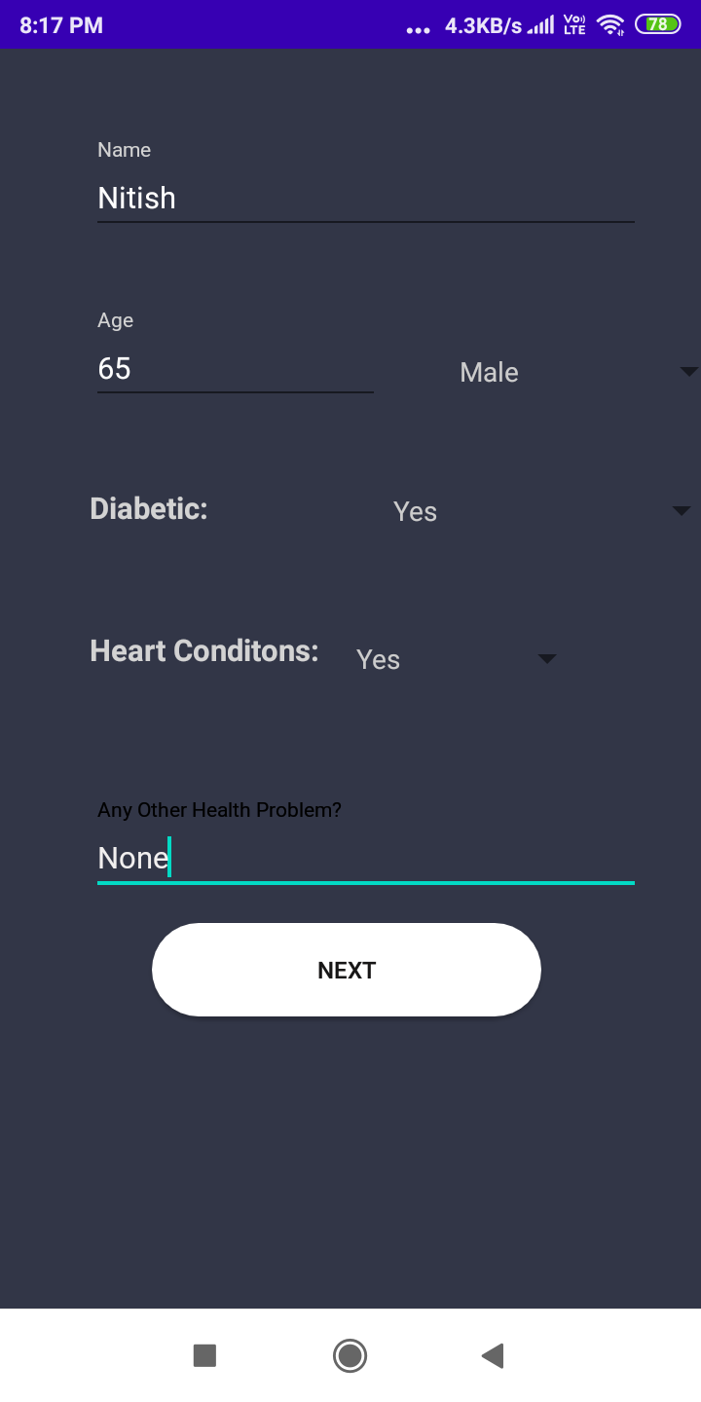
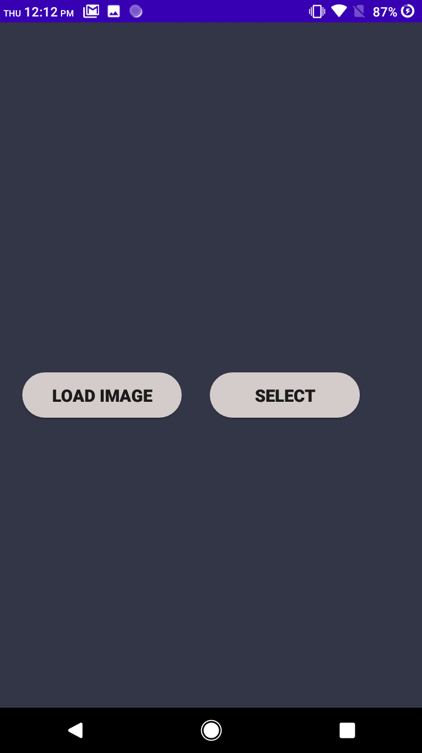
Introduction
Patient Info
Load Image and Select image from gallery

Slide 12
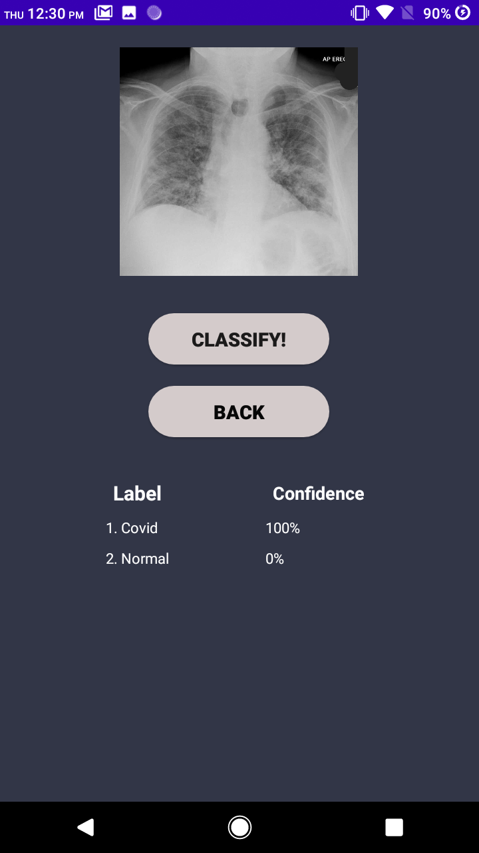
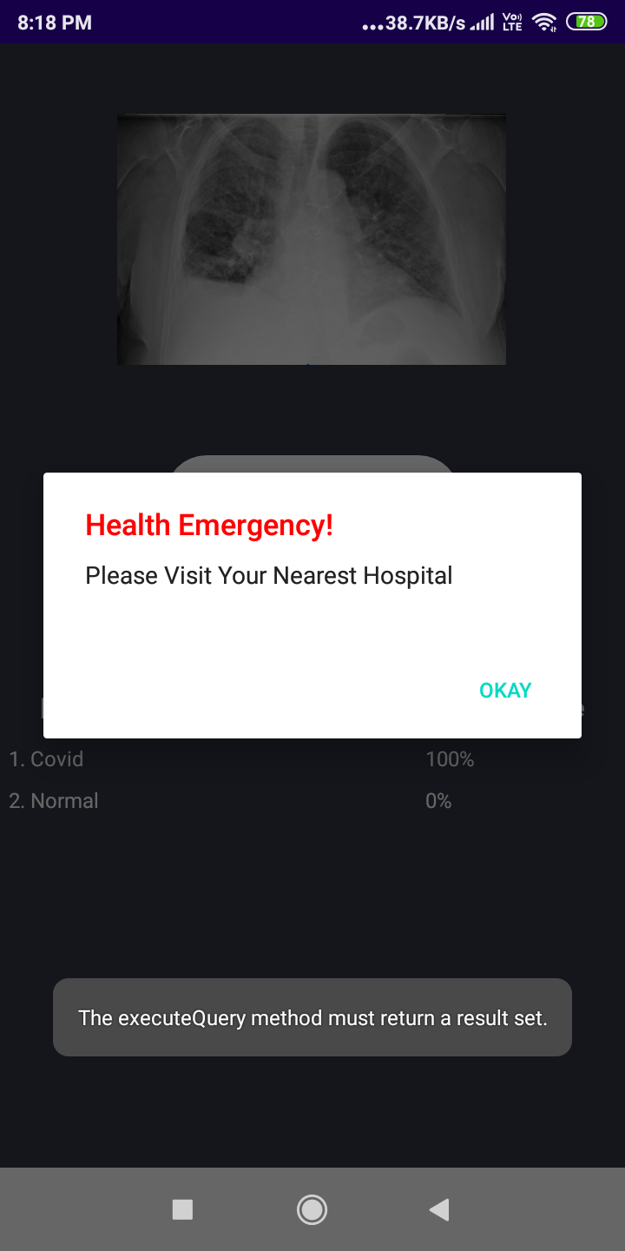
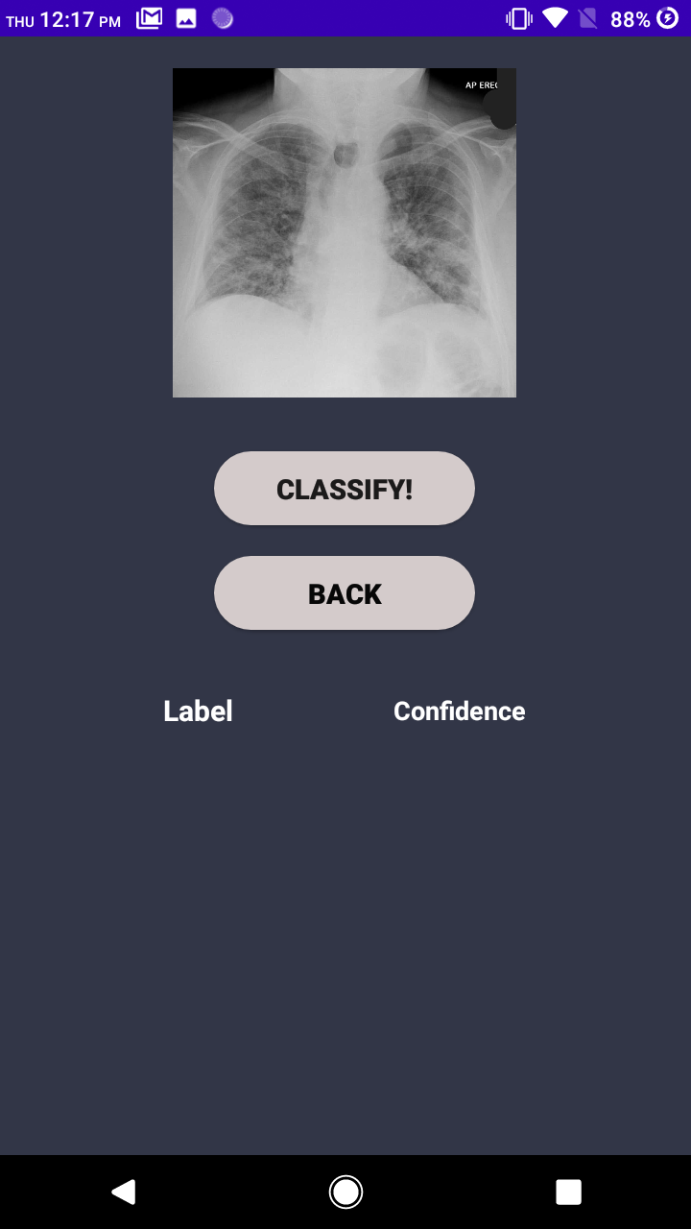
Click on Classify Button
Check The Result
Alert if Patient in Danger

Slide 13
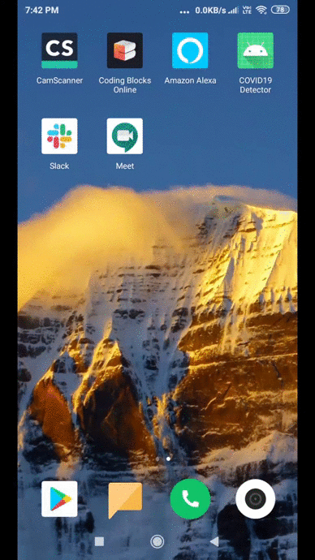
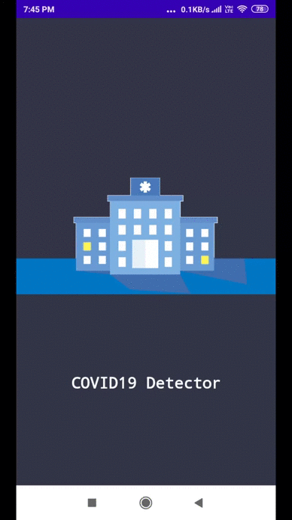
Prototype
Covid Prediction
Normal Prediction

Slide 14
We will use deep learning and Convolutional Neural networks to and Transfer Learning Train the model on the dataset
The data set is divided in two partition images of healthy people and images of people who have Covid_19
We will train the data and build a model and make our prediction
Application of Idea
* The deep learning model like CNN learn the image and extract features and help us in identifying key areas in Xray that help us detect Covid_19 patients
* The model that is build will help us classify between healthy and covid infected person
* Thus that model can be used in Our Android Phone and then we can build a Application for covid detection
* The Application will take Xray images and tell us if the patient has covid_19 or not

Slide 15
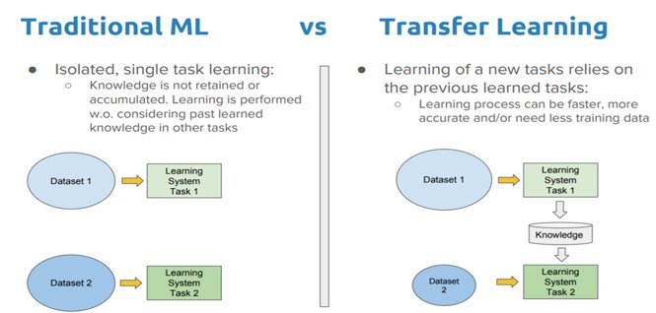
We Use Transfer Learning to build our model​
We can give the new dataset to fine tune the pre-trained CNN. Consider that the new dataset is almost similar to the original dataset used for pre-training.​
Since the new dataset is similar, the same weights can be used for extracting the features from the new dataset.
​ If the new dataset is very small, it’s better to train only the final layers of the network to avoid overfitting, keeping all other layers fixed. ​
So remove the final layers of the pre-trained network. Add new layers . Retrain only the new layers. If the new dataset is very much large, retrain the whole network with initial weights from the pretrained model.​ ​

Slide 16
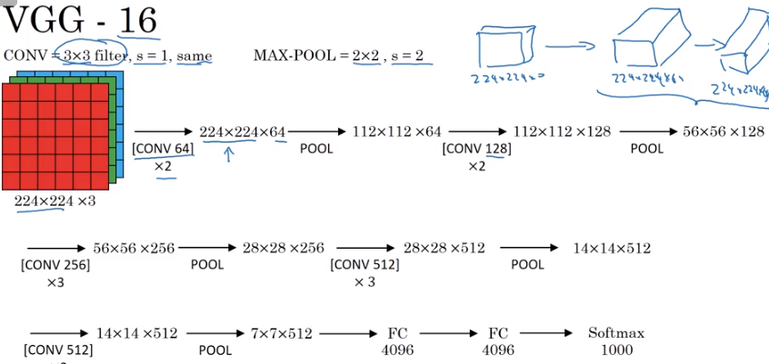
VGG-16 | CNN model
The ImageNet Large Scale Visual Recognition Challenge (ILSVRC) is an annual computer vision competition. Each year, teams compete on two tasks. The first is to detect objects within an image coming from 200 classes, which is called object localization. The second is to classify images, each labeled with one of 1000 categories, which is called image classification. VGG 16 was proposed by Karen Simonyan and Andrew Zisserman of the Visual Geometry Group Lab of Oxford University in 2014 in the paper “VERY DEEP CONVOLUTIONAL NETWORKS FOR LARGE-SCALE IMAGE RECOGNITION”. This model won the 1st and 2nd place on the above categories in 2014 ILSVRC challenge.
This model achieves 92.7% top-5 test accuracy on ImageNet dataset which contains 14 million images belonging to 1000 classes.

Slide 17


Convolutional Neural Network

Slide 18
Layers used to build ConvNets
A covnets is a sequence of layers, and every layer transforms one volume to another through differentiable function.
Types of layers:
Input Layer: This layer holds the raw input of image with width 32, height 32 and depth 3
Convolution Layer: This layer computes the output volume by computing dot product between all filters and image patch. Suppose we use total 12 filters for this layer we’ll get output volume of dimension 32 x 32 x 12.
Activation Function Layer: This layer will apply element wise activation function to the output of convolution layer. Some common activation functions are RELU: max(0, x), Sigmoid: 1/(1+e^-x), Tanh, Leaky RELU, etc. The volume remains unchanged hence output volume will have dimension 32 x 32 x 12.
Pool Layer: This layer is periodically inserted in the covnets and its main function is to reduce the size of volume which makes the computation fast reduces memory and also prevents from overfitting. Two common types of pooling layers are max pooling and average pooling. If we use a max pool with 2 x 2 filters and stride 2, the resultant volume will be of dimension 16x16x12.
Fully-Connected Layer: This layer is regular neural network layer which takes input from the previous layer and computes the class scores and outputs the 1-D array of size equal to the number of classes.

Slide 19
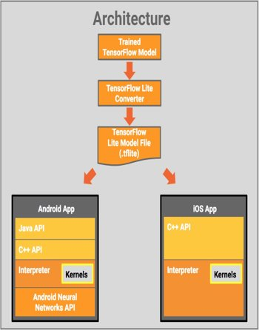
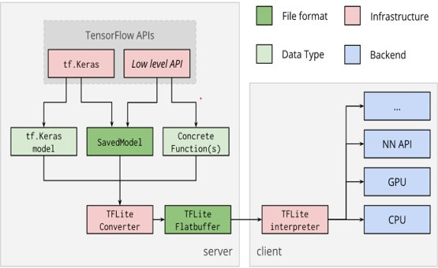
The Tensorflow Model is Converted to Tensorflow Lite Model and Used in Android App​
​ TensorFlow Lite is comprised of a runtime on which you can run pre-existing models, and a suite of tools that you can use to prepare your models for use on mobile and embedded devices.​ ​
It’s presently supported on Android and iOS via a C++ API, as well as having a Java Wrapper for Android Developers.
Additionally, on Android Devices that support it, the interpreter can also use the Android Neural Networks API for hardware acceleration, otherwise it will default to the CPU for execution.

Slide 20
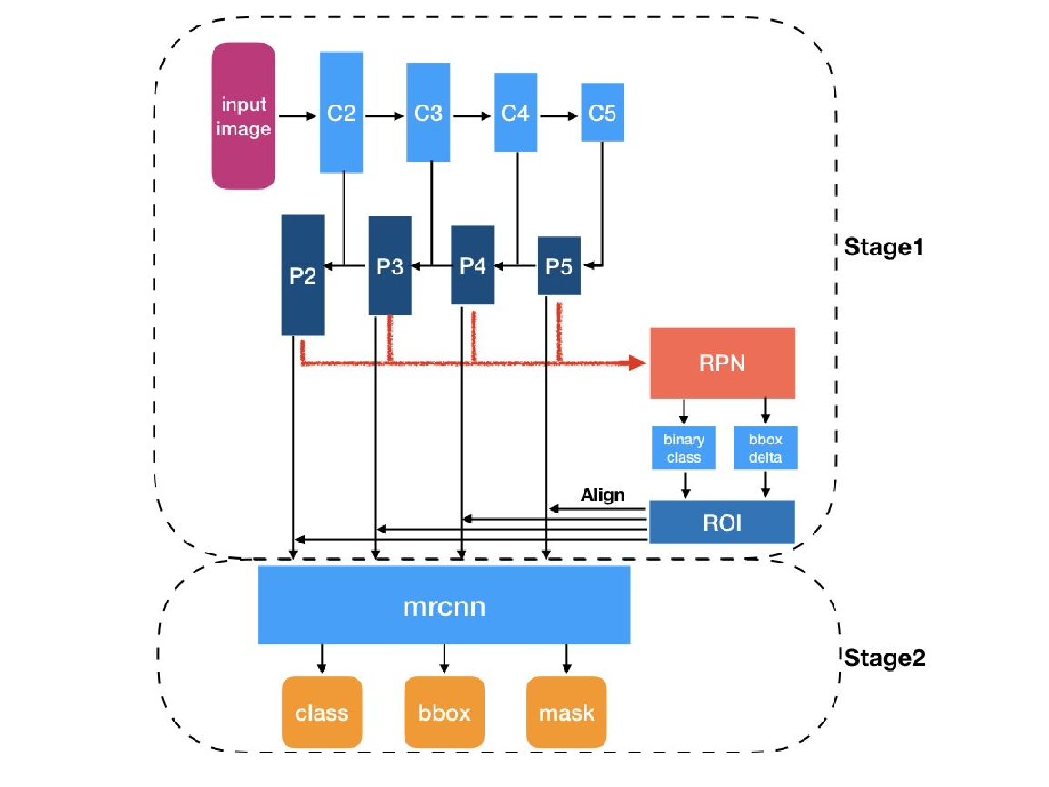
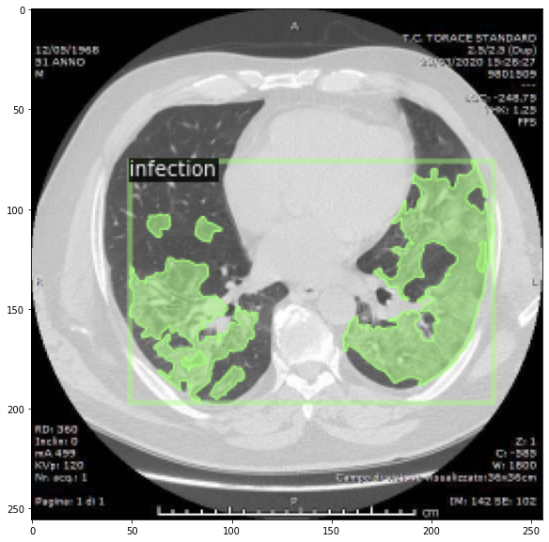
Future Scope and Research
Creating a deep learning model to predict mask for the infection in lungs
The model uses mask rcnn neural network with Resnet-50 FPN network which is used for instance segmentation

Slide 21
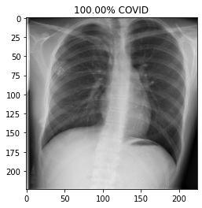
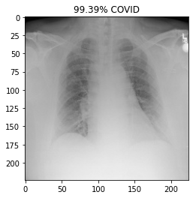
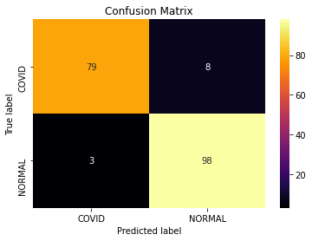
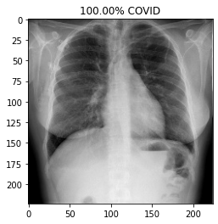
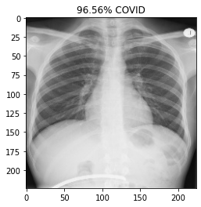
Results

Slide 22
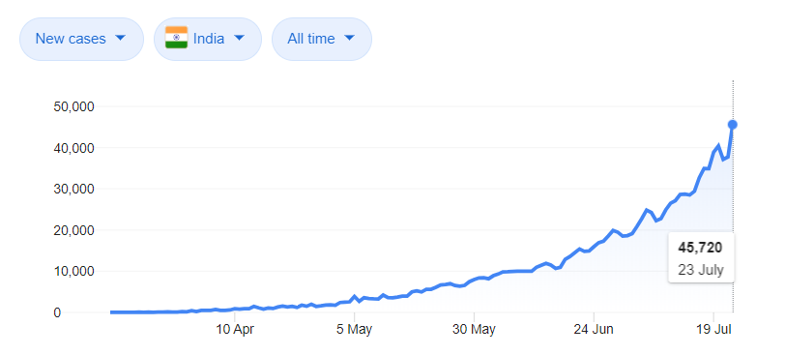
Why This App is unique and essential
The App can help us in testing the disease at initial stage
As we know the cases are rising and we have limited beds in hospital,there arises a dilemma of who is the patient that should be admitted,We can judge the patient not by age for this, but by the spread of virus in lungs
We have almost reached 50k patient as of now,if we can properly segregate serious patient using our App and give them proper treatment we can lower fatality rate
Using the segmentation and classification of virus radiologist we can research the spread of virus
The data stored in sql database will help us in Exploratory Data analysis and co-relate co-morbidities,virus and fatality

Slide 23
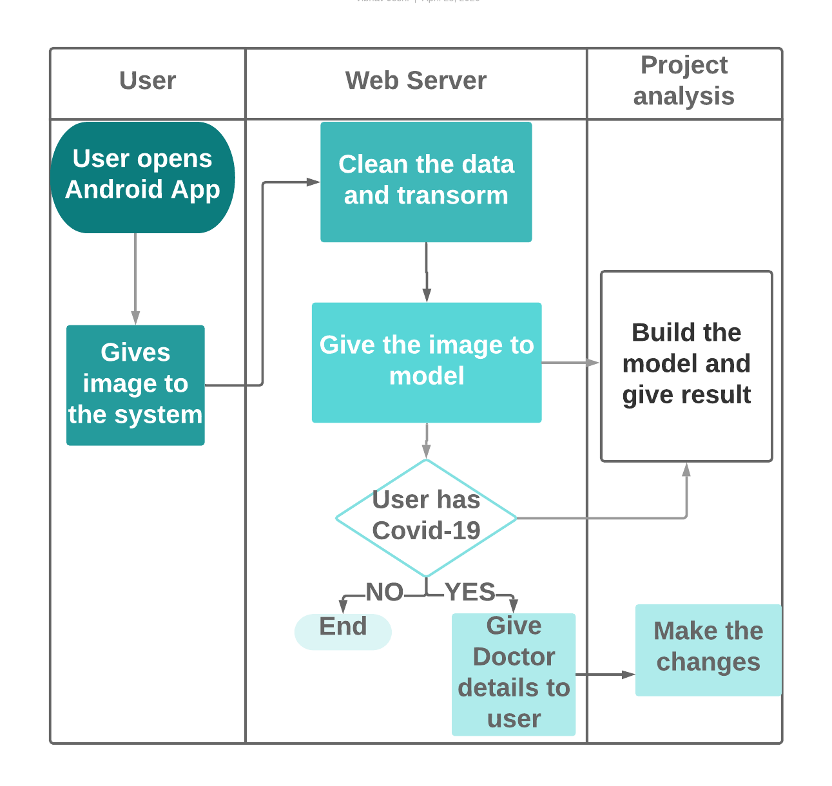
System Architecture

